Slide 1
Week 8-Lec 1
IP addressing-II

Slide 2
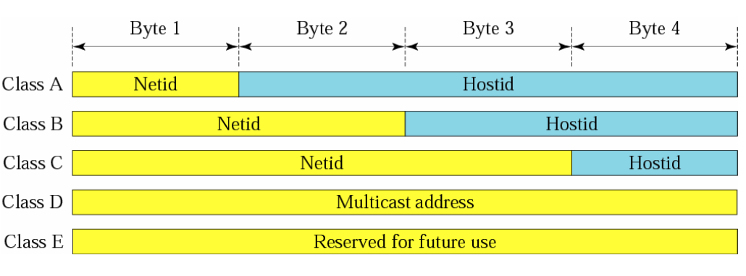
Network and Host IDs

Slide 3
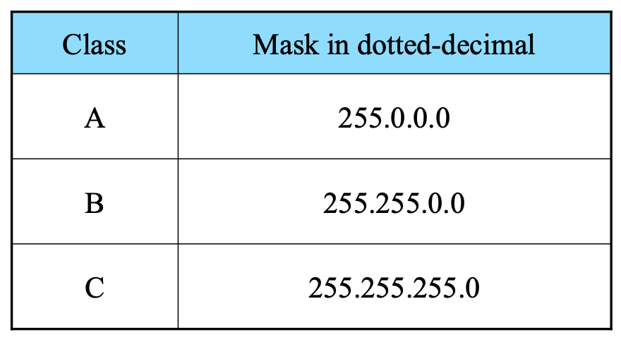
Subnet Mask

Slide 4
Given the address 23.56.7.91 and the default class A mask, find the beginning address (network address).
The default mask is 255.0.0.0, which means that only the first byte is preserved and the other 3 bytes are set to 0s. The network address is 23.0.0.0.
Given the address 132.6.17.85 and the default class B mask, find the beginning address (network address).
The default mask is 255.255.0.0, which means that the first 2 bytes are preserved and the other 2 bytes are set to 0s. The network address is 132.6.0.0.

Slide 5
Methods of allocating addresses?
Classful
Fixed Length Subnet Mask (FLSM)
Variable Length Subnet Mask(VLSM)

Slide 6
Subnetting Types
There are three types of subnetting examples :
1) Subnetting when given a required number of networks
2) Subnetting when given a required number of clients
3) Given an IP address & Subnet Mask, finding original network range

Slide 7
You have a Class C network, and you need ten subnets. Each subnet should get as many number of addresses for hosts as possible. How would you break the network ? What is the new subnet mask?
Solution steps:
How many subnets required?
How many bits can I modify?
How many bits can I retain for hosts and give away for subnets?
2^{x} = 10
Closest but highest value – 4.
2⁴=16 networks possible
16> 10 , no other number close to 10
If 4 bits have to be given , retain remaining 4 bits starting from Right most bit to left in the default subnet mask
255.255.255.0 = 1 1 1 1 1 1 1 1. 1 1 1 1 1 1 1 1 .1 1 1 1 1 1 1 1. 0 0 0 0 0 0 0 0
New subnet?

Slide 8
You have a Class C network, and you need ten subnets. Each subnet should get as many number of addresses for hosts as possible. How would you break the network ? What is the new subnet mask?
Solution steps:
How many subnets required? 10
How many bits can I modify? 8 bits since it is class C
How many bits can I retain for hosts and give away for subnets?
2^{x} = 10
Closest but highest value – 4.
2⁴=16 networks possible
16> 10 , no other number close to 10
If 4 bits have to be given , retain remaining 4 bits starting from Right most bit to left in the default subnet mask
255.255.255.0 = 1 1 1 1 1 1 1 1. 1 1 1 1 1 1 1 1 .1 1 1 1 1 1 1 1. 0 0 0 0 0 0 0 0
= 1 1 1 1 1 1 1 1. 1 1 1 1 1 1 1 1 .1 1 1 1 1 1 1 1. 1 1 1 1 0 0 0 0
New subnet mask = 255.255.255.240
16 subnets, each subnet accommodates 16 hosts.

Slide 9
Requirement
if nwk, then
{
step 1:2^{x}=num_{Nwks}
step 2: 0s to 1s and compute new subnet mask
step 3: getting separate subnets
Compute →. 2(^{last possible network bit)}
step 4: Allott IP addresses
}
This will tell us how many bits to give 0s to 1s (L2R) and how many to retain

Slide 10
Requirement
if host, then
{
step 1:2^{x}=num_{Hosts}
step 2: 0s to 1s and compute new subnet mask
step 3: getting separate subnets
Compute →. 2(^{last possible network bit)}
step 4: Allot IP addresses
}
This will tell us how many bits to retain(R2L) and how many to convert to 1's
This will get us the desired number of hosts with
fixed number of subnets.
This will give you the range for each subnet
first and last cannot be : first is subnet addr, last is broadcast addrs for that subnet. 2nd-lastbutone are usable host addresses.

Slide 11
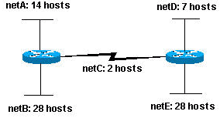
Questions
A service provider has given you the Class C network range 209.50.1.0. Your company must break the network into as many subnets as possible as long as there are at least 50 clients per network.
A service provider has given you the Class C network range 204.15.5.0. Your company must break the network into 20 separate subnets.
Given the Class C network of 204.15.5.0, use the Topology 1 to create subnets.
A service provider has given you the Class C network range 209.50.1.0 using the Your company must break the network as shown below
Topology 1

Slide 12
Net A = 14hosts, Net B = 28 hosts, Net C = 2 hosts, Net D = 7 hosts, Net E = 28 hosts
Default Subnet Mask : 255.255.255.0
Step 1: number of bits to retain in the last octet(for largest host requirement i.e., 28): 5 (2⁵=32)
Step 2: New subnet mask : 255.255.255.11100000 = 255.255.255.224
Step 3: Find the multiples to break the subnets = Last network bit value = 2⁵=32
Step 4: break the sbnets
5.0 ------- 5.31
5.32 ------- 5.63
5.63 --------- 5.95
5.95 -------- 5. 127
5.127 --------- 5. 159
….
Now, largest subnet Net B can be given subnet 5.0 ------- 5.31. (5.0/27)
Next largest subnet net E can be given subnet 5.32 ------- 5.63. (5.32/27)
Next largest subnet net A requires 14 hosts, further subnetting could result in 16 addresses on total i.e., give away one more bit 2⁴ but since we need total of 16 addresses (subnet and broadcast ), we cannot go with only 16, so we retain same subnet mask /27 5.64 ---------- 5.95 (5.64/27)
Now, the next subnet net D needs only 7 hosts. We can break the 32 addresses subnet into smaller but sufficient address space network. Since we cannot go with 2³=8, we go with 2⁴=16 addresses. In other words, we are giving away one more bit to network part, so 2¹=2 subnets. 1 subnet broken into 2 smaller subnets with 16 total addresses in each .
New subnet mask: 255.255.255.11110000 = 255.255.255.240
Step 3: Find the multiples to break the subnet 5.95 – 5.111 . Last bit is 2⁴ = 16. so
5.96 ------- 5.111. Assign this subnet to Network D
5.112 -------- 5.127 Assign this subnet to Network E
But net E needs only a total of 4 addresses since there are 2 routers and one subnet and broadcast Address.
So we can break this subnet. Number of bits to retain for hosts is exactly – 2 (2²=4)
New subnet mask = 255.255.255.11111100 = 255.255.255.252.
Step 3: Find the multiples to break the subnet 5.112 – 5.127. Last network bit is 2² = 4. so breaking this subnet into 4 smaller subnets
5.112 ------ 5.115 – Assign this to the Router-Router network
Remaining addresses unused.
5.116 ------- 5.119
5.120 -------- 5.123
……

Slide 13
Network ID | Subnet | Subnet Address | Broadcast Address | Usable Host Addresses
A (14hosts) | 5.64 ---------- 5.95 (5.64/27) | 5.64 | 5.95 | 5.65-5.94
B (28 hosts) | 5.0 ------- 5.31. (5.0/27) | 5.0 | 5.31 | 5.1-5.30
C (2 hosts) | 5.112 ------ 5.115 | 5.112 | 5.115 | 5.113-5.114
D (7 hosts) | 5.96 ------- 5.111. (5.96/28) |  |  | 5.97-5.110
E (28 hosts) | 5.32 ------- 5.63. (5.32/27) | 5.32 | 5.63 | 5.33-5.62

Slide 15

NAT: network address translation
NAT: all devices in local network share just one IPv4 address as far as outside world is concerned
rest of
Internet
local network (e.g., home network) 10.0.0/24
10.0.0.1
138.76.29.7
10.0.0.4
10.0.0.2
10.0.0.3
all datagrams leaving local network have same source NAT IP address: 138.76.29.7, but different source port numbers
datagrams with source or destination in this network have 10.0.0/24 address for source, destination (as usual)

Slide 16
NAT: network address translation
all devices in local network have 32-bit addresses in a “private” IP address space (10/8, 172.16/12, 192.168/16 prefixes) that can only be used in local network
advantages:
just one IP address needed from provider ISP for all devices
can change addresses of host in local network without notifying outside world
can change ISP without changing addresses of devices in local network
security: devices inside local net not directly addressable, visible by outside world

Slide 17
NAT: network address translation
implementation: NAT router must (transparently):
outgoing datagrams: replace (source IP address, port #) of every outgoing datagram to (NAT IP address, new port #)
remote clients/servers will respond using (NAT IP address, new port #) as destination address
remember (in NAT translation table) every (source IP address, port #) to (NAT IP address, new port #) translation pair
incoming datagrams: replace (NAT IP address, new port #) in destination fields of every incoming datagram with corresponding (source IP address, port #) stored in NAT table

Slide 18
NAT: network address translation
NAT translation table
WAN side addr LAN side addr
2: NAT router changes datagram source address from 10.0.0.1, 3345 to 138.76.29.7, 5001,
updates table
1: host 10.0.0.1 sends datagram to 128.119.40.186, 80
138.76.29.7, 5001 10.0.0.1, 3345
…… ……
S: 10.0.0.1, 3345
D: 128.119.40.186, 80
10.0.0.1
1
2
S: 138.76.29.7, 5001
D: 128.119.40.186, 80
10.0.0.4
10.0.0.2
138.76.29.7
S: 128.119.40.186, 80
D: 10.0.0.1, 3345
4
S: 128.119.40.186, 80
D: 138.76.29.7, 5001
3
10.0.0.3
3: reply arrives, destination address: 138.76.29.7, 5001

